Slide 1


CSN -254
FINAL PROJECT
ARTHUB

Slide 2
MEMBERS:
BINDU 20114024
DEEPANSHU 20114030
DEEPANSHU MEENA 20114031
Y0UWAN SONI 20114107
PRIYA SINGH 20114077
SONALI GUPTA 20114094

Slide 3









ARTHUB

Slide 4
Basic project description
This is basically an art appreciation app. We host competitions among the artists and at the same time to support them financially connects them to the art lovers from around the world and provides them with a platform to showcase their talent and make money out of it.

Slide 5
Key Features
Our project has a variety of features some of the major ones are mentioned below:
1. First of all it has a smooth and interactive interface .
2. It supports various types of artists like painters, photographers, digital artists, color pencil artists etc.
3. Provides the art appreciators with a platform where they can easily choose between different arts of their interest and buy it immediately like some of the today’s online shopping apps (flipkart , amazon).
Some more important features are explained in detail in the upcoming slides.

Slide 6
Free/paid Competitions
In our app we have both paid as well as free art competitions in which artists can participate according to their interest.
The free competitions are visible when we click on the dashboard icon under free competitions icon.
The paid competitions can be accessed when the user clicks on any of the arts that are available for selection on the home page and can be found under the ongoing tab.
The attractive qualities of these competitions is that whether paid or free they have a prize pool for the first three positions and also the good art from the competition are directly uploaded on the store from where they can be bought by the art lovers.

Slide 7
Design Diagrams Activity Diagram

Slide 8
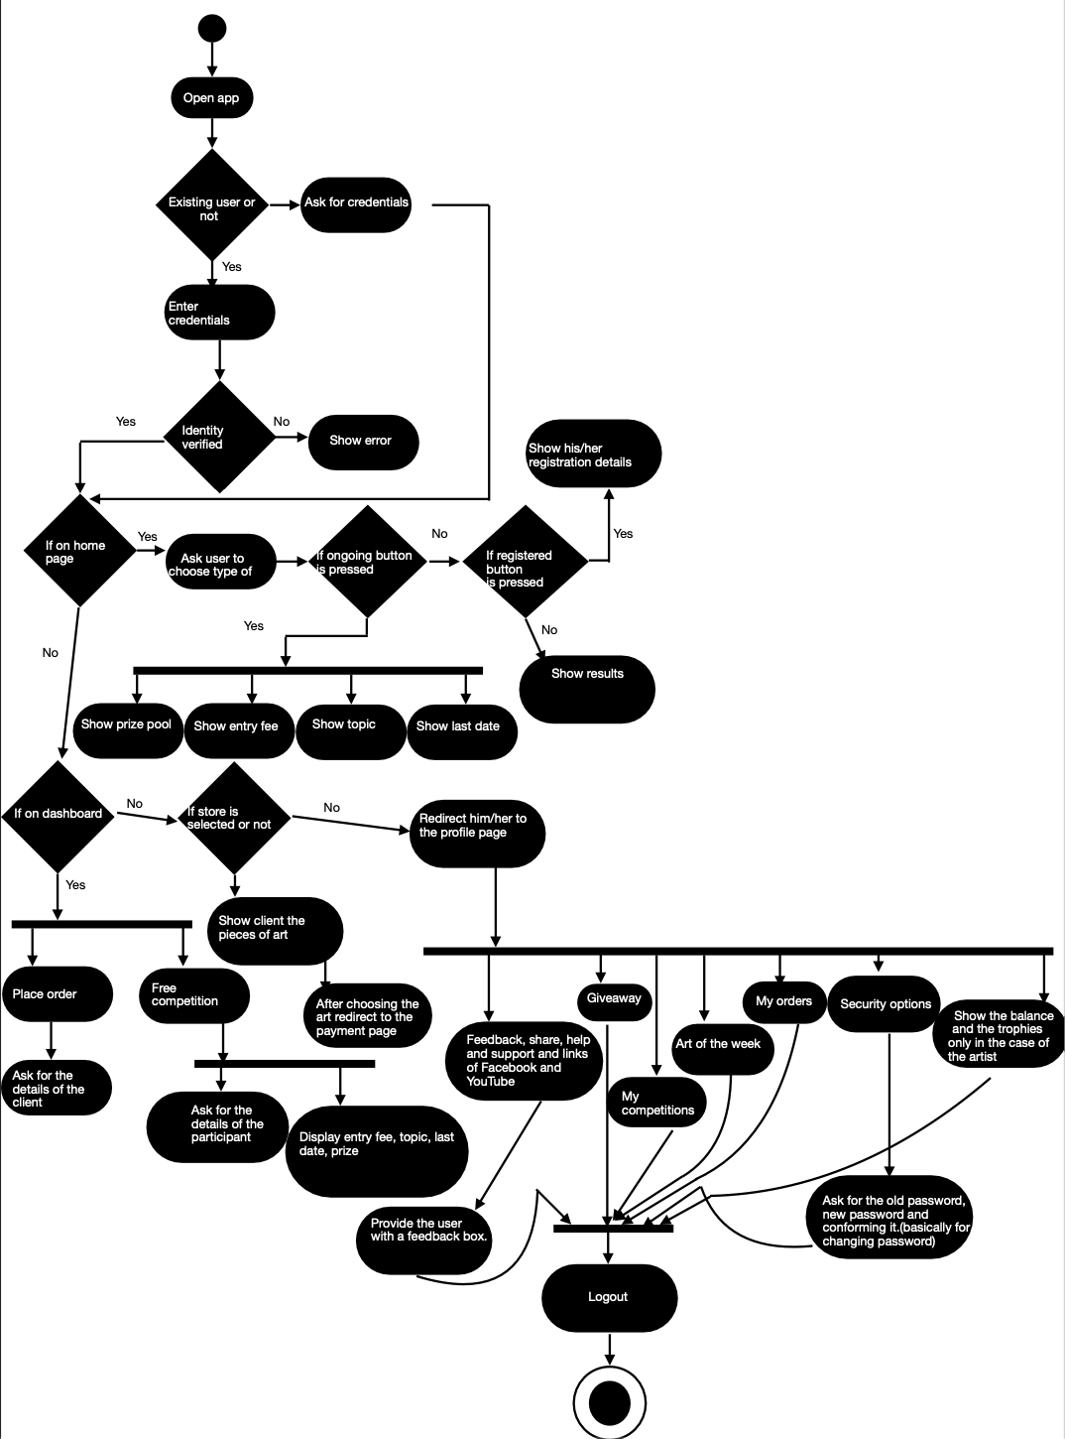
As we all know that Activity diagram basically represents the flow of control in a system or basically the order in which different activities are being performed in the system with time.

Slide 9
Class Diagram

Slide 10
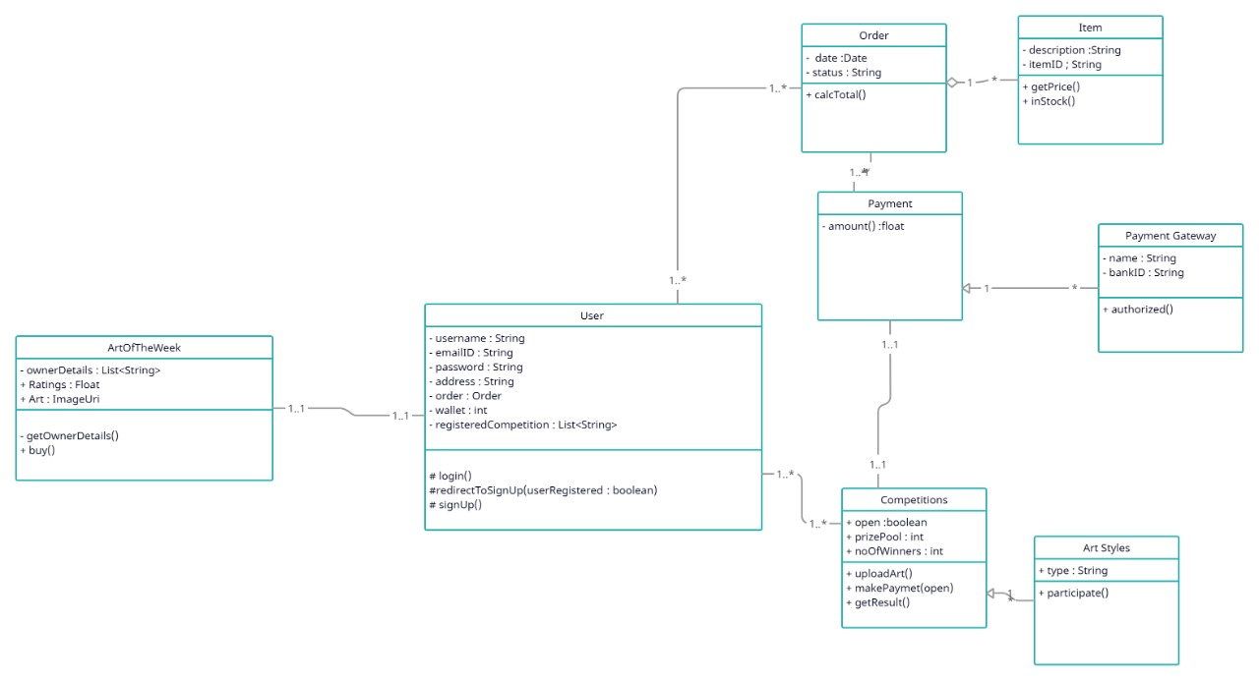
As it is known to us that the class diagram is a static diagram basically it shows us that how the system is implemented with the help of different classes and the specific relations between different classes.
It also tells us the access specifiers of different variables used in a class and the return type of different methods included in a class

Slide 11
Data Flow Diagram

Slide 12
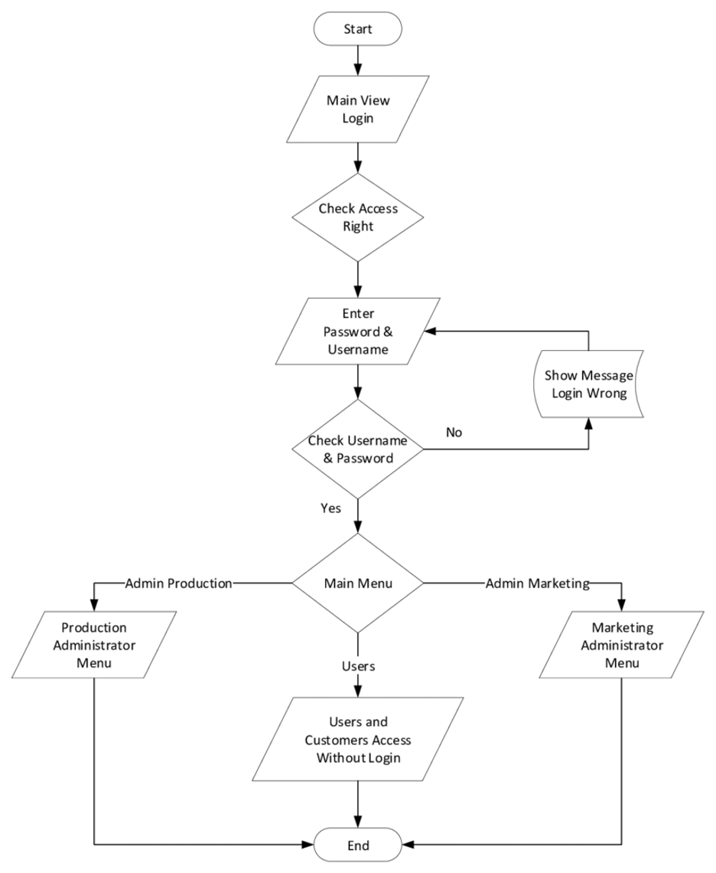
A Data Flow Diagram basically tells us the flow of information in a process or a system
It shows us the incoming data, outgoing data and the stored data and the various subprocesses through which the data flows.

Slide 13
Use Case Diagram

Slide 14
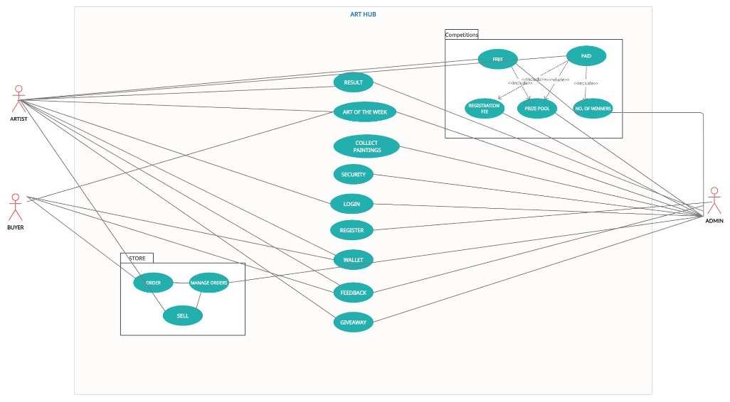
Basically, a use case diagram shows us the details of how the system’s users(Actors) will interact with the system.
The use cases are the tasks being performed by the system and the actors are those who compel the system to perform these tasks.

Slide 15
Some screenshots and working of the app

Slide 16
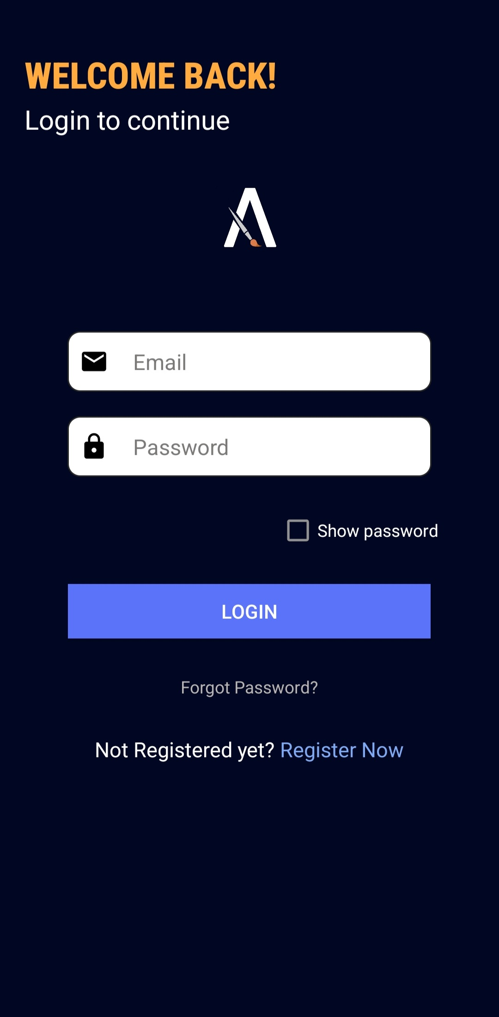
This is our login page where the user can enter his/her crendentials or create a new account

Slide 17
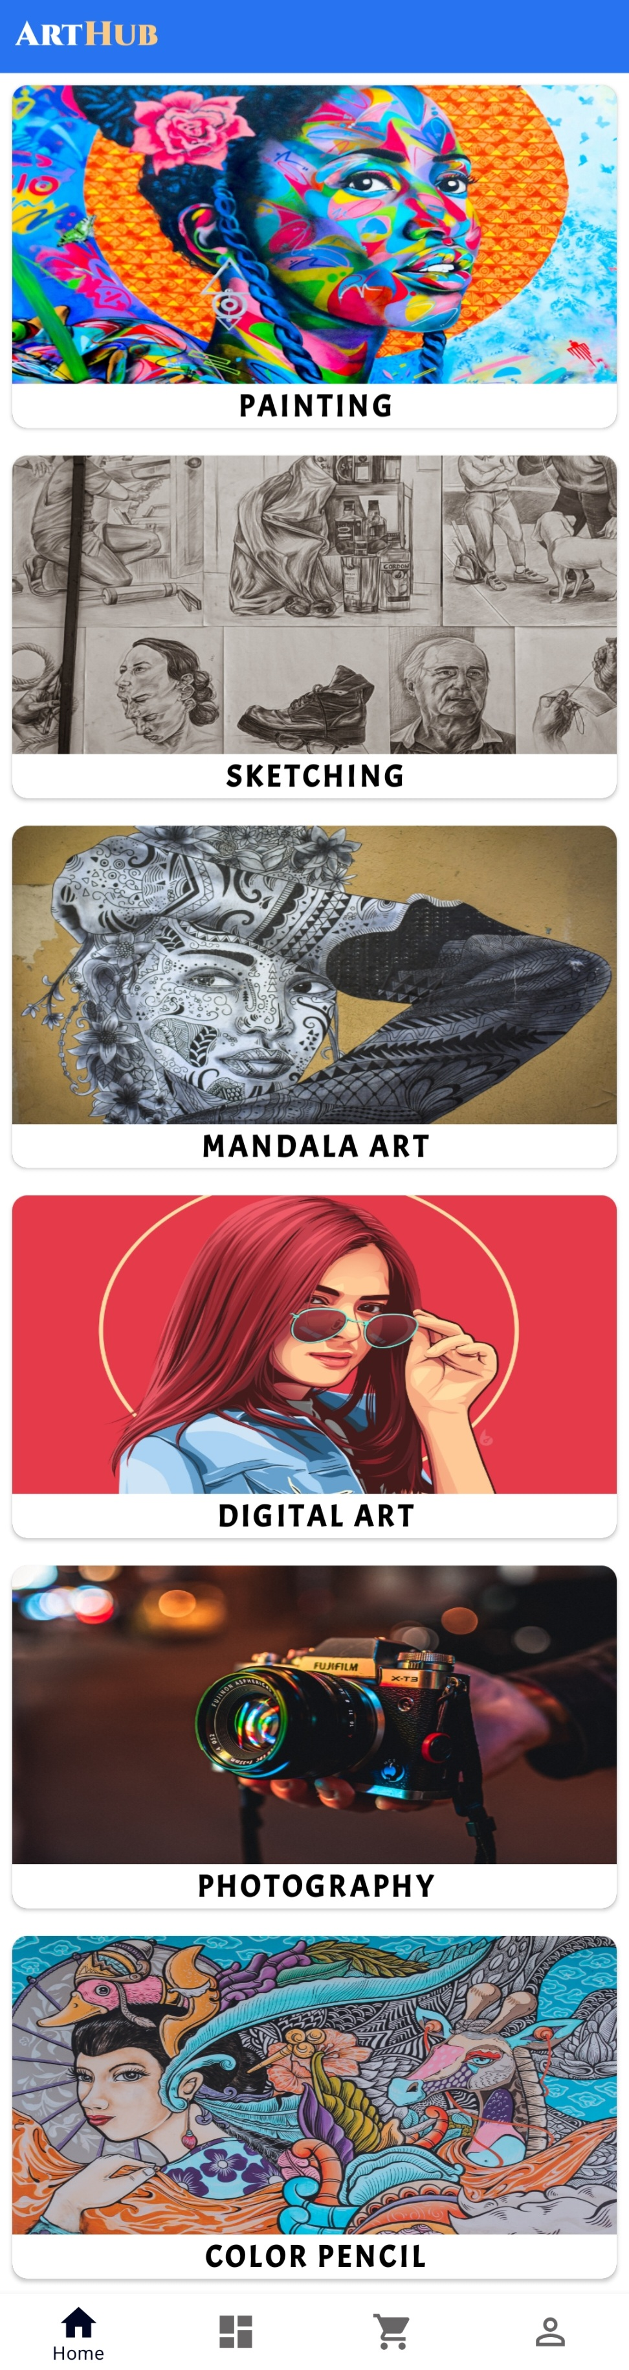
This is our home page it opens by defaults when one logs in . It has tabs for all the arts in which the competitions are held.

Slide 18
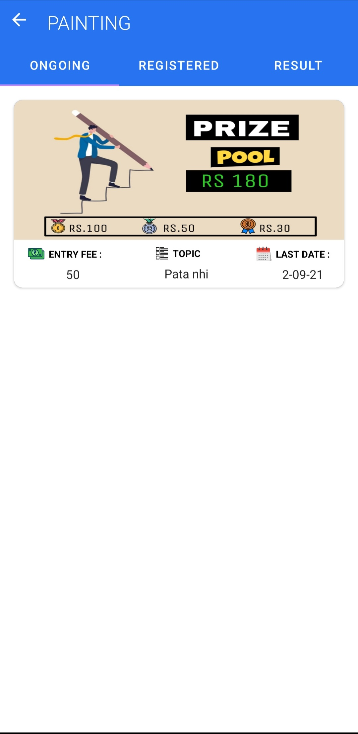
The page after clicking any of the available arts.

Slide 19
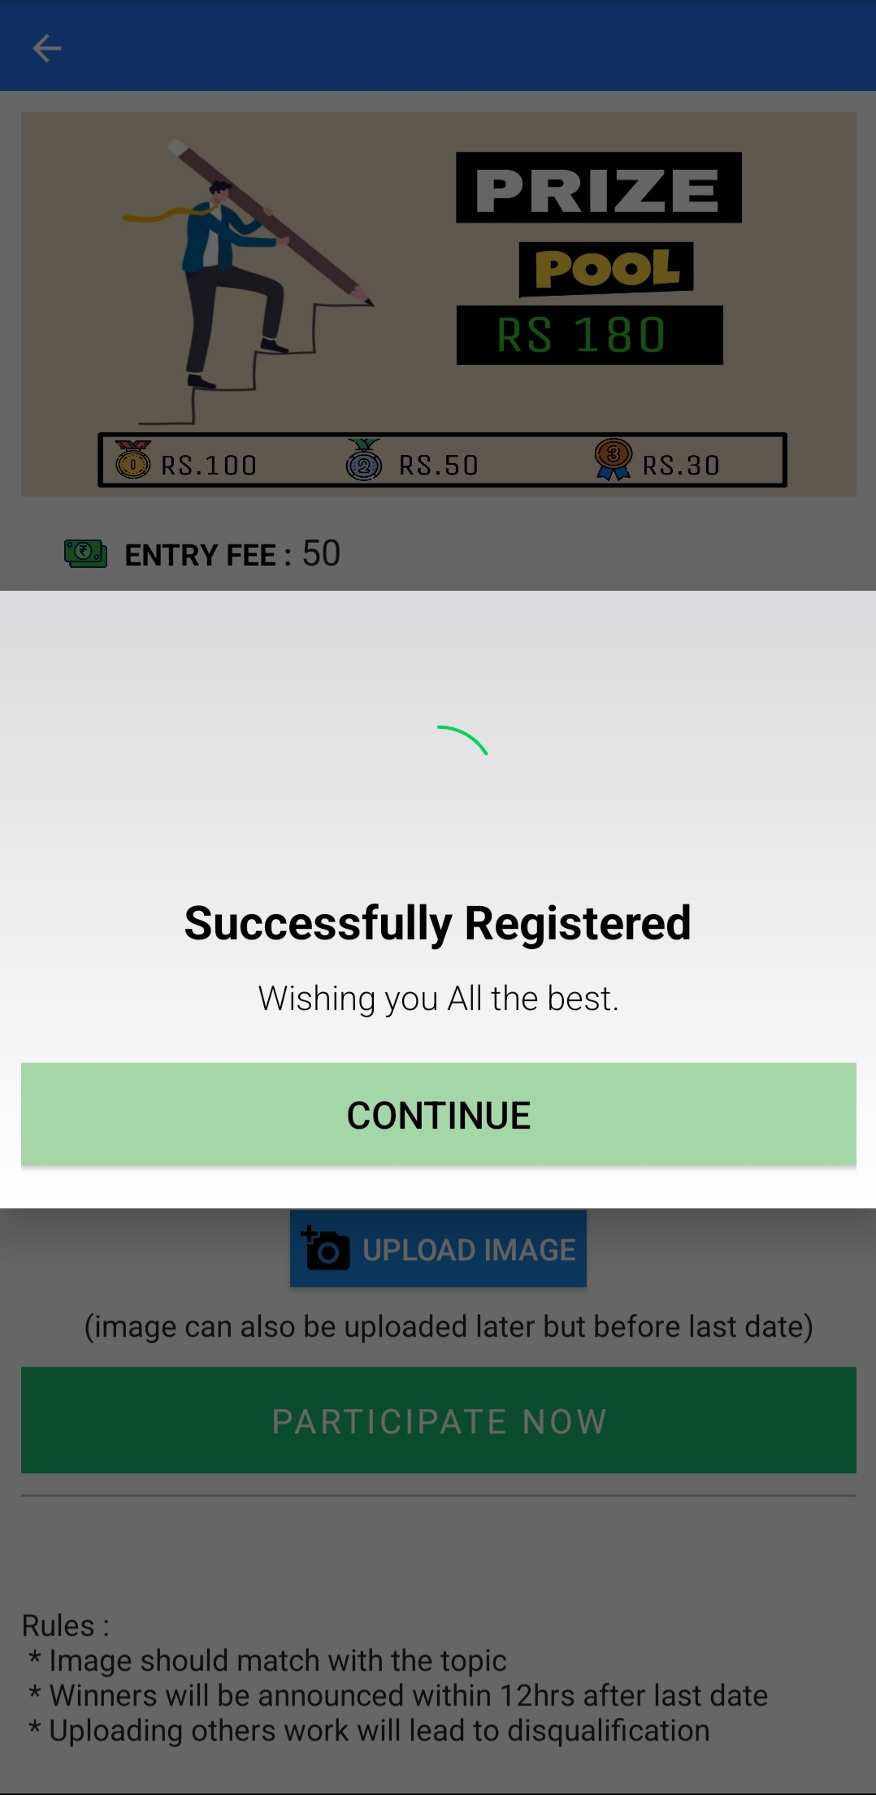
This is the page that opens when successfully registers in the paid competitions through UPI or any other payment method

Slide 20
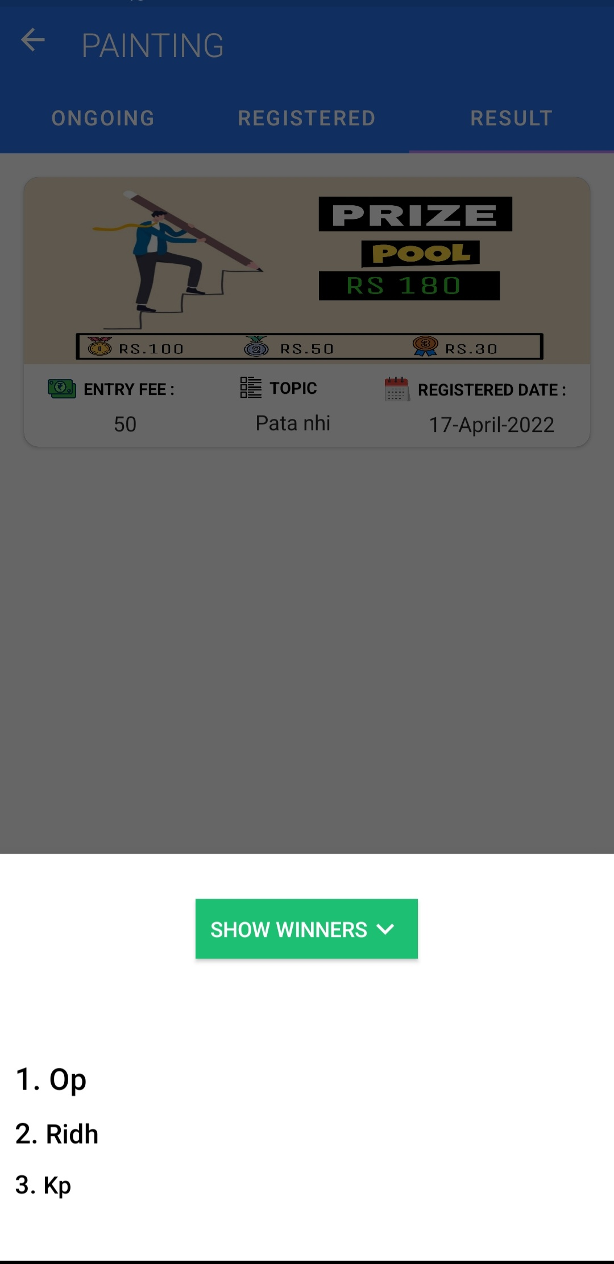
This is the page after we successfully registered for the competition the winners of the competition are shown.

Slide 21
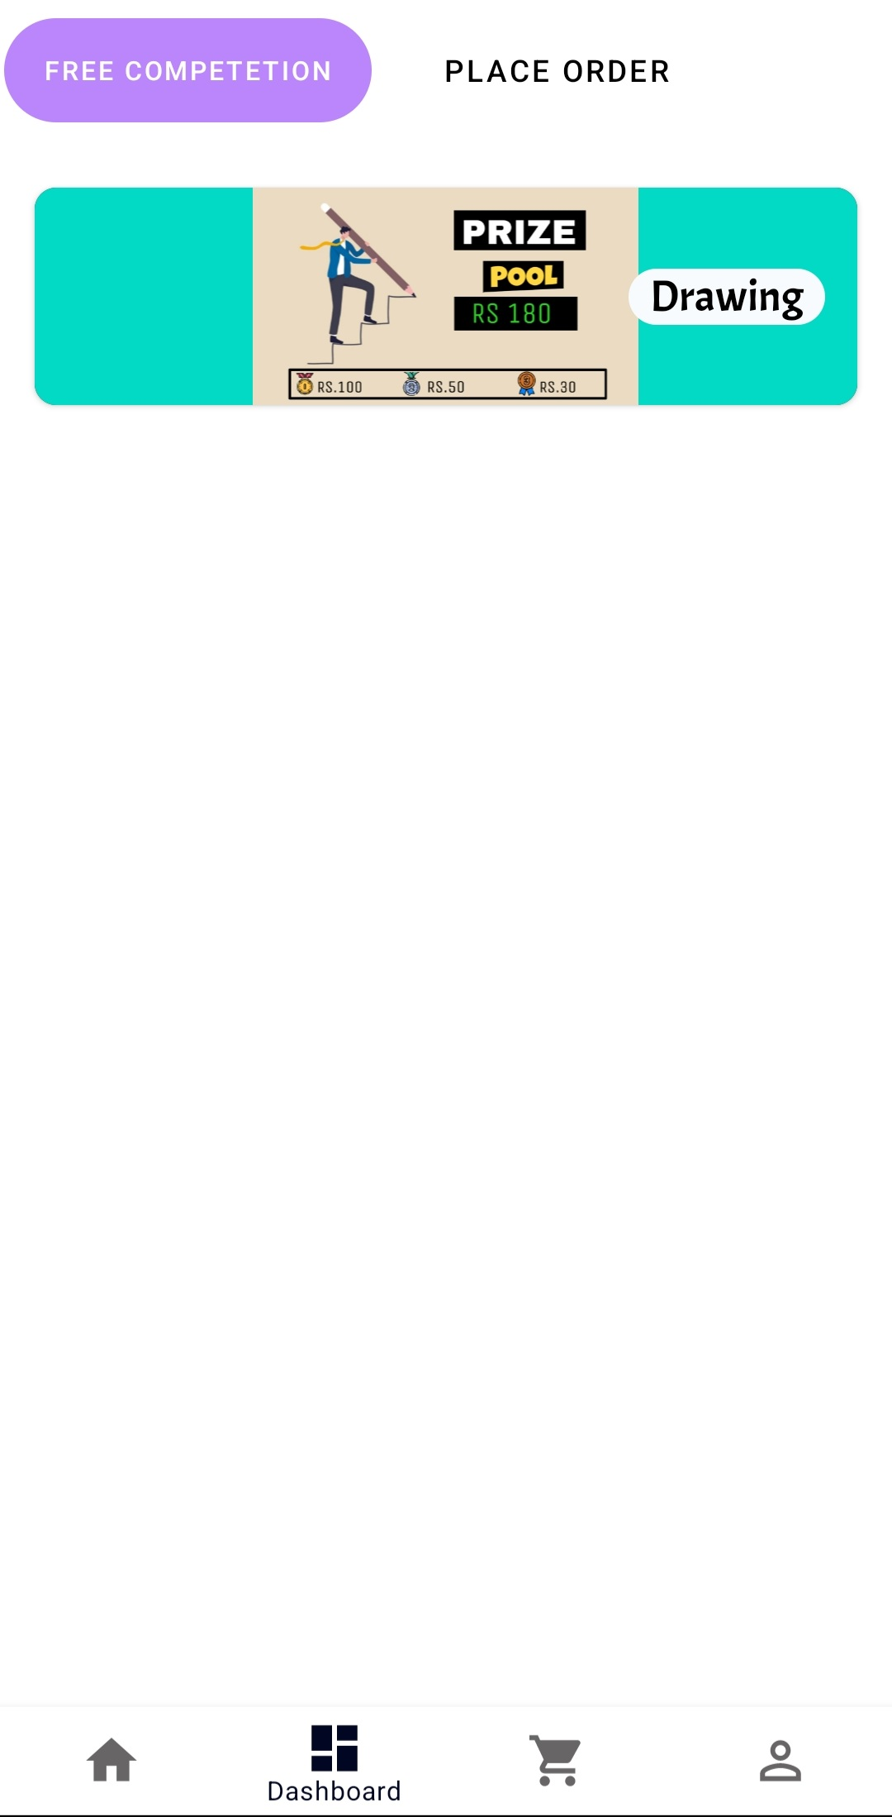
This is our dashboard. Under the free competition tab one can find competitions that have no entry fee

Slide 22
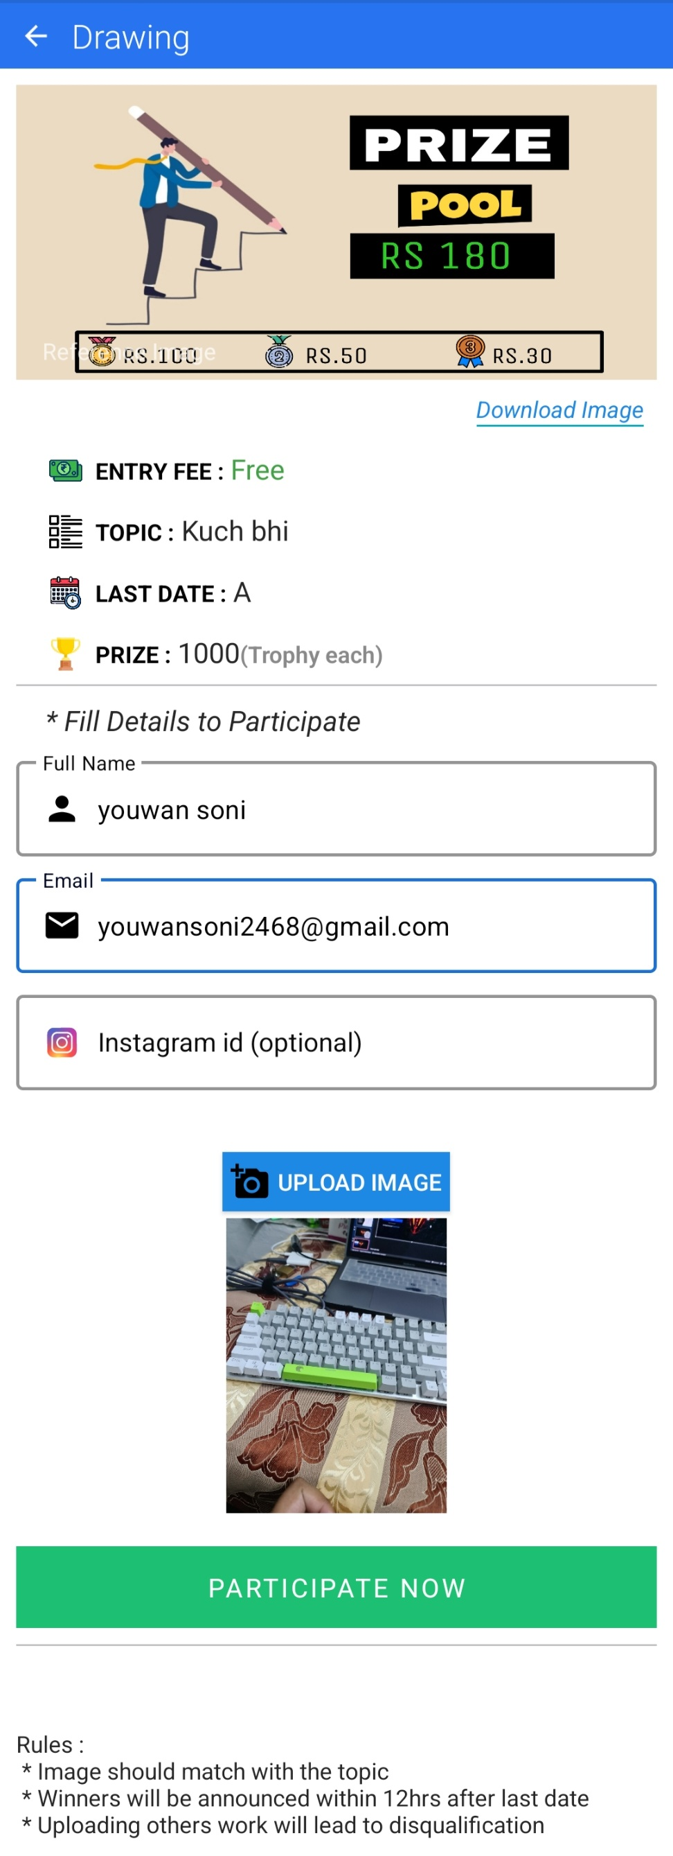
This is the registration page of the free competition by filling up some details and uploading the art’s photo.

Slide 23
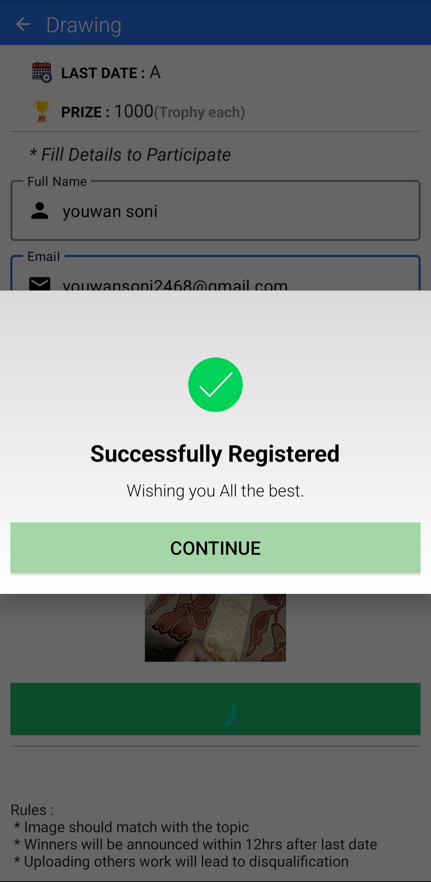
This page opens when one successfully registers for the free competition.

Slide 24
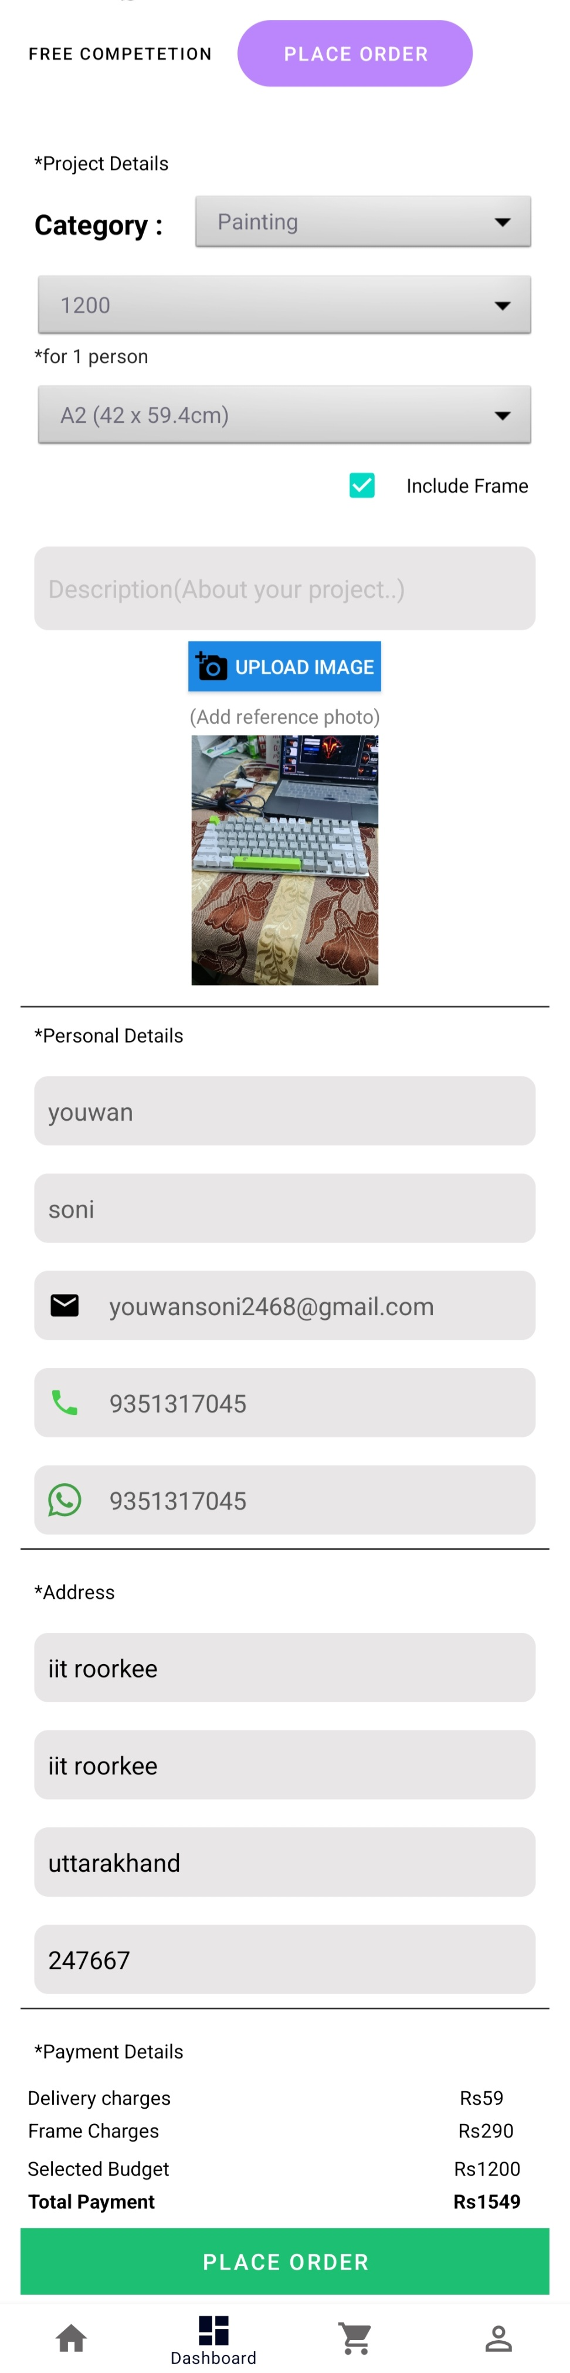
This is the place order tab under this before placing the order the user have to fill in some details. Then directed to the payment gateway.

Slide 25
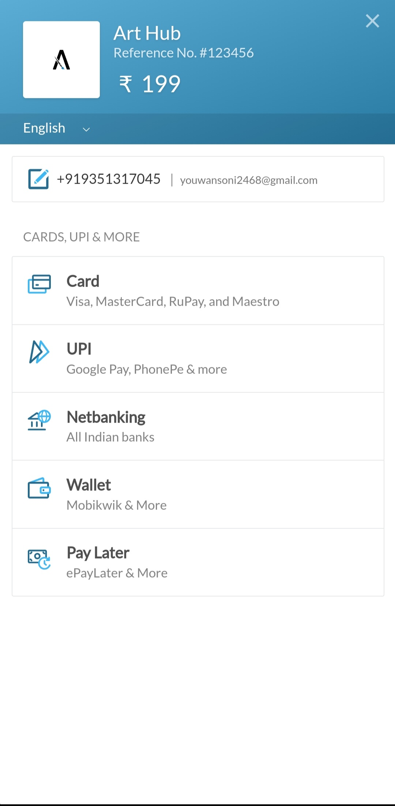
This is the payment API the user is directed to having various methods of payment.

Slide 26
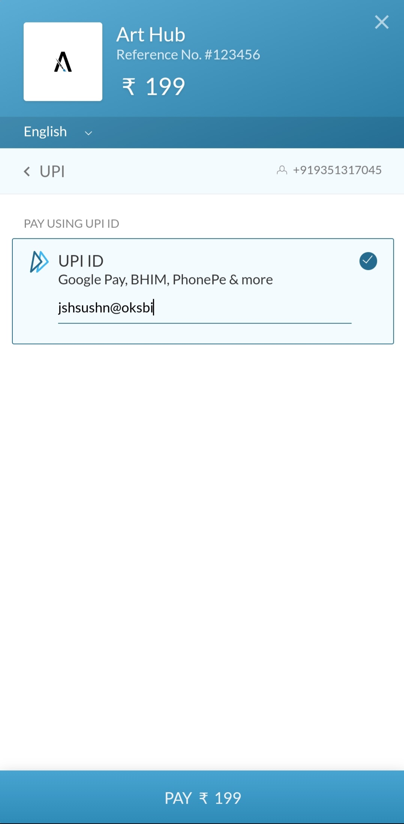
Here one has to enter his/her upi id.

Slide 27
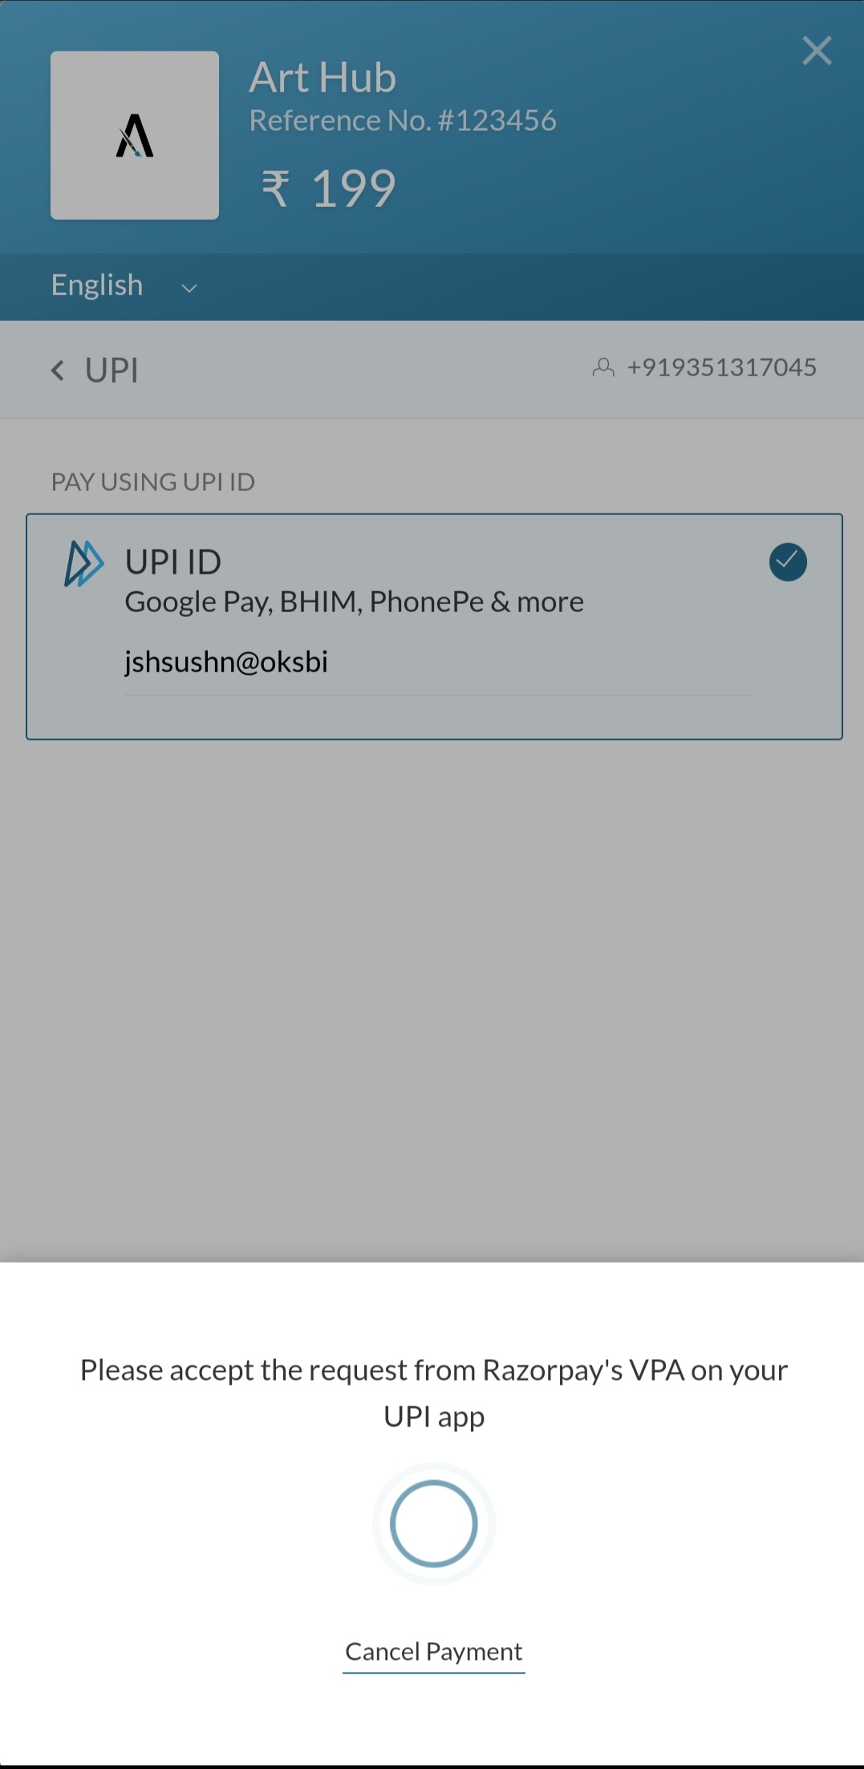
This is basically the page when the payment is taking place.

Slide 28
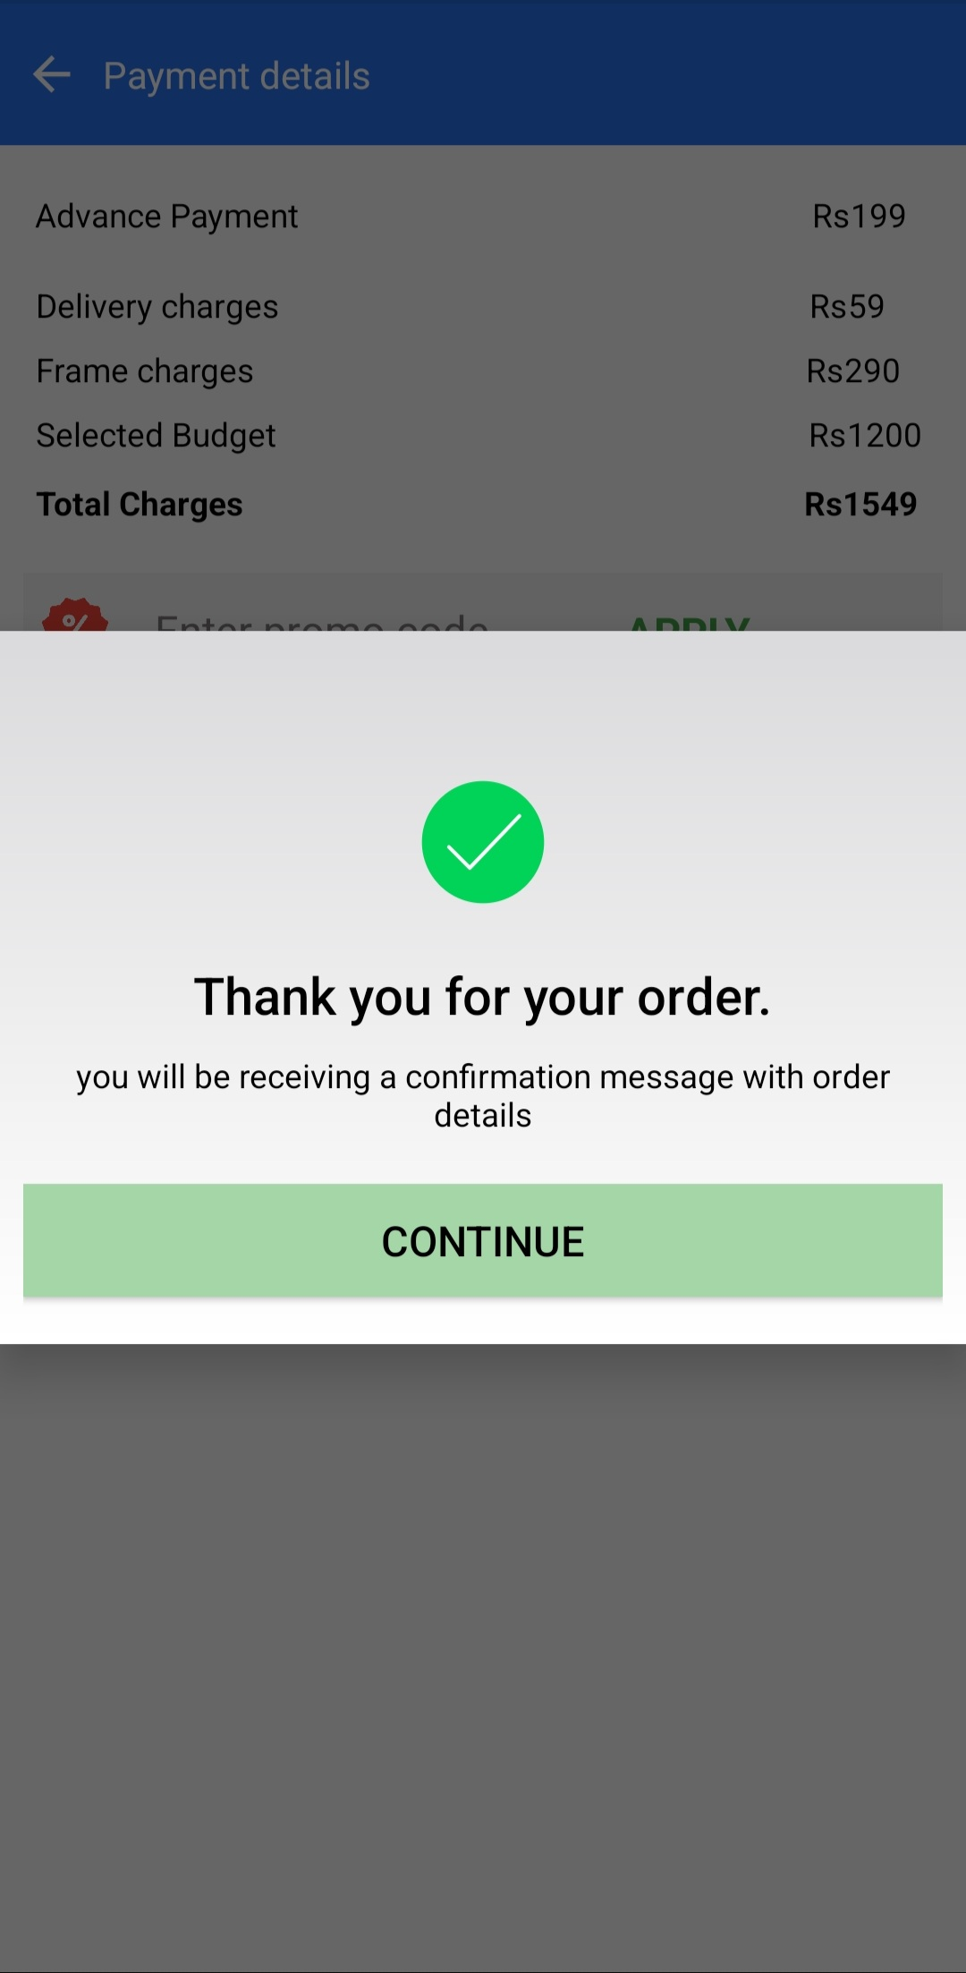
This is the order conformation page.

Slide 29
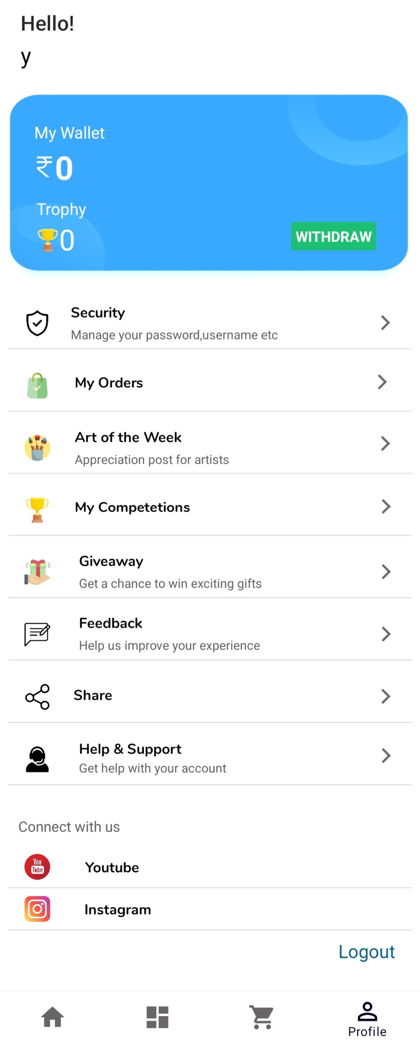
Now coming to the last page i.e. the profile page. It has many tabs whose meaning can be easily understood by their name itself.

Slide 30
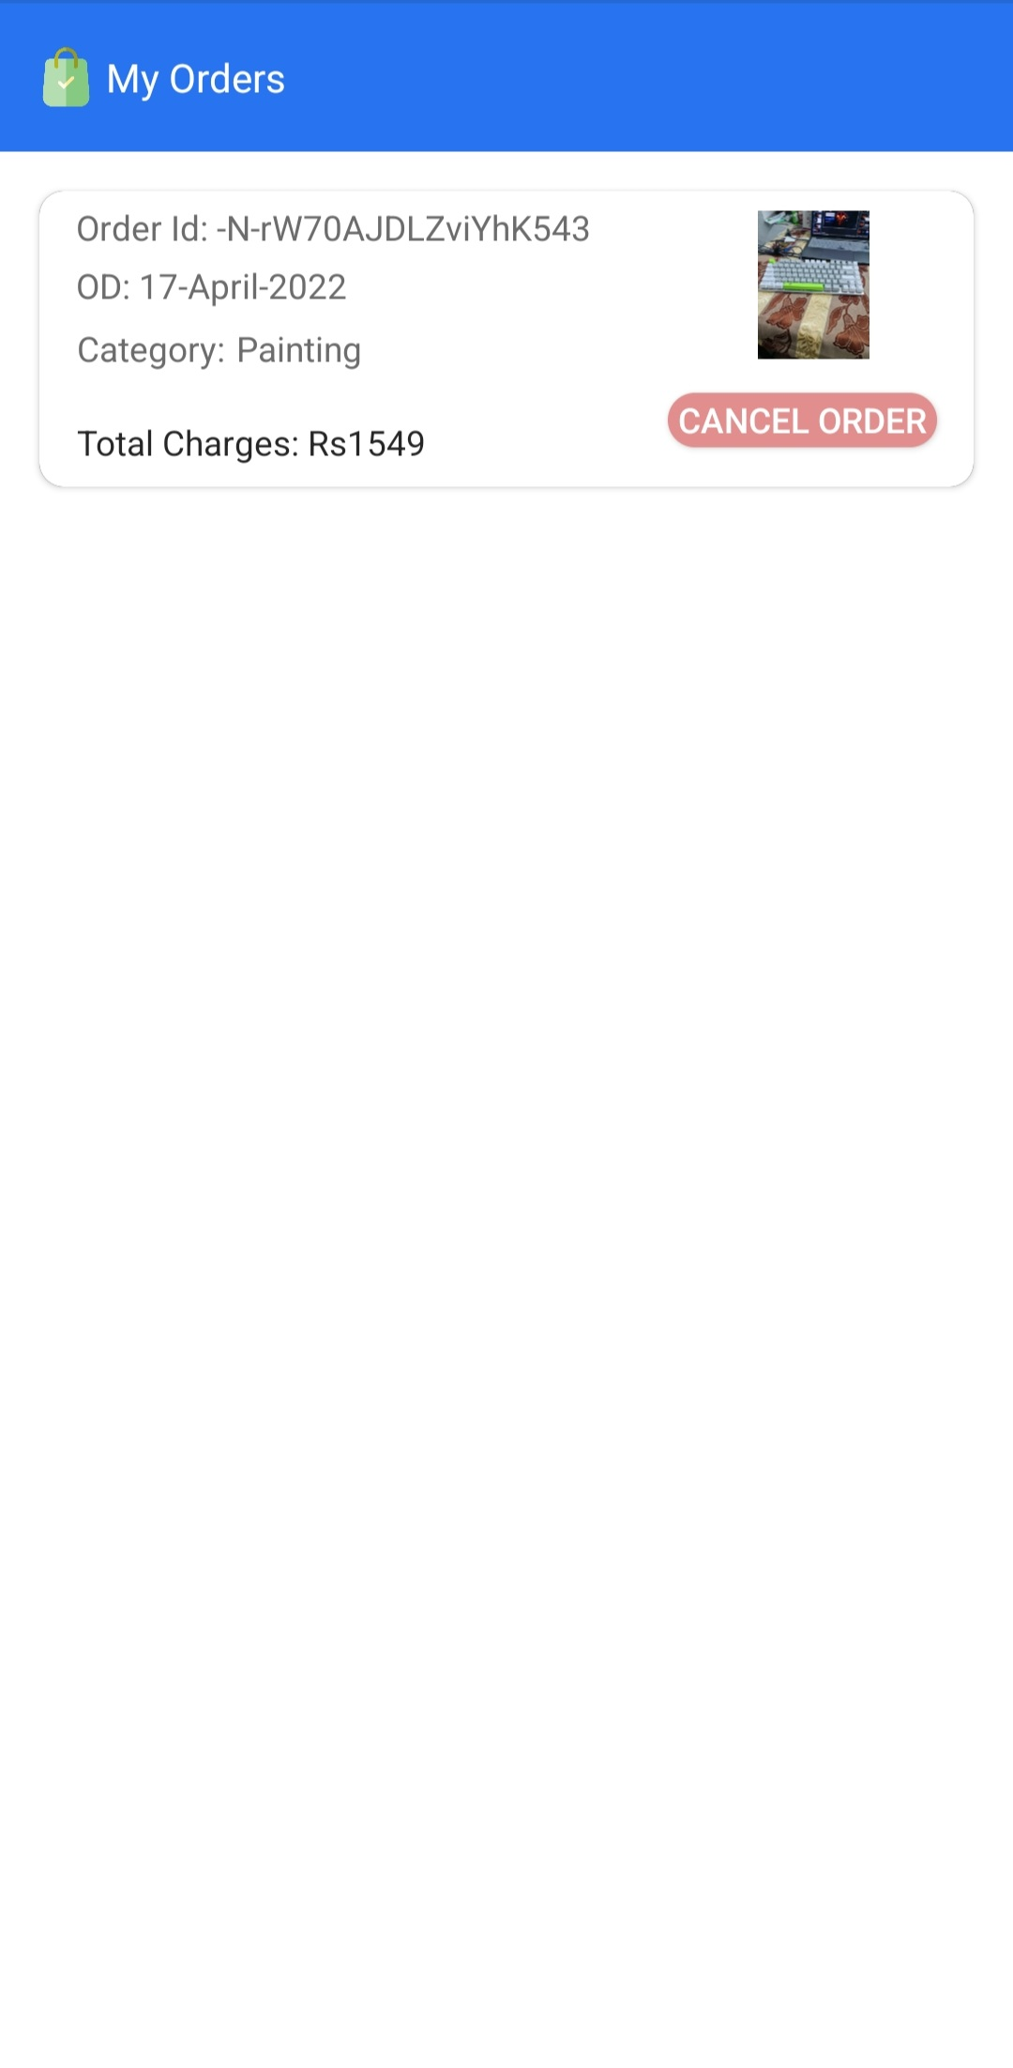
This is the My Orders tab showing the orders made by the user.

Slide 31

This is my competitions tab which basically shows the competitions in which the user has participated in.

Slide 32
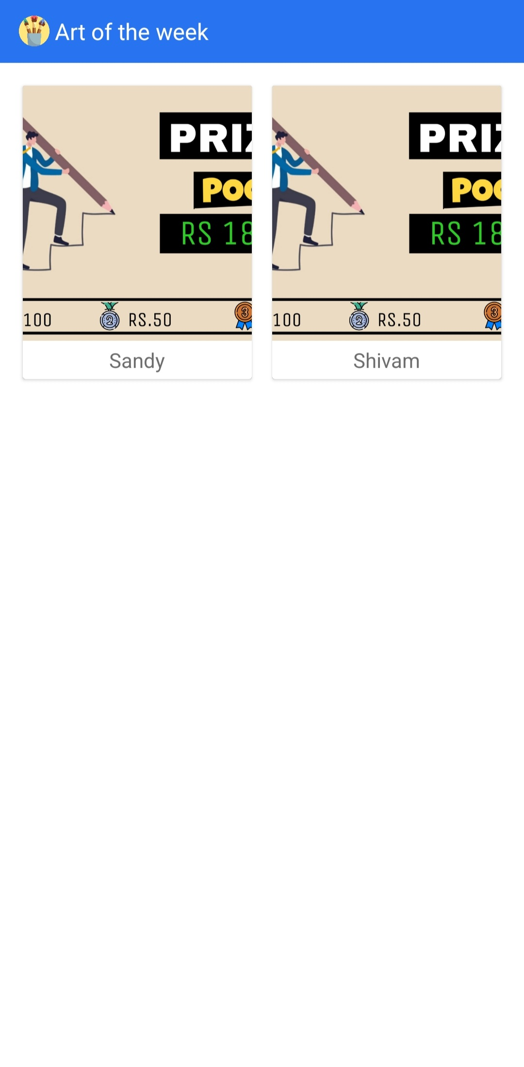
This is the art of the week tab.

Slide 33
Thank you

